Slide 1
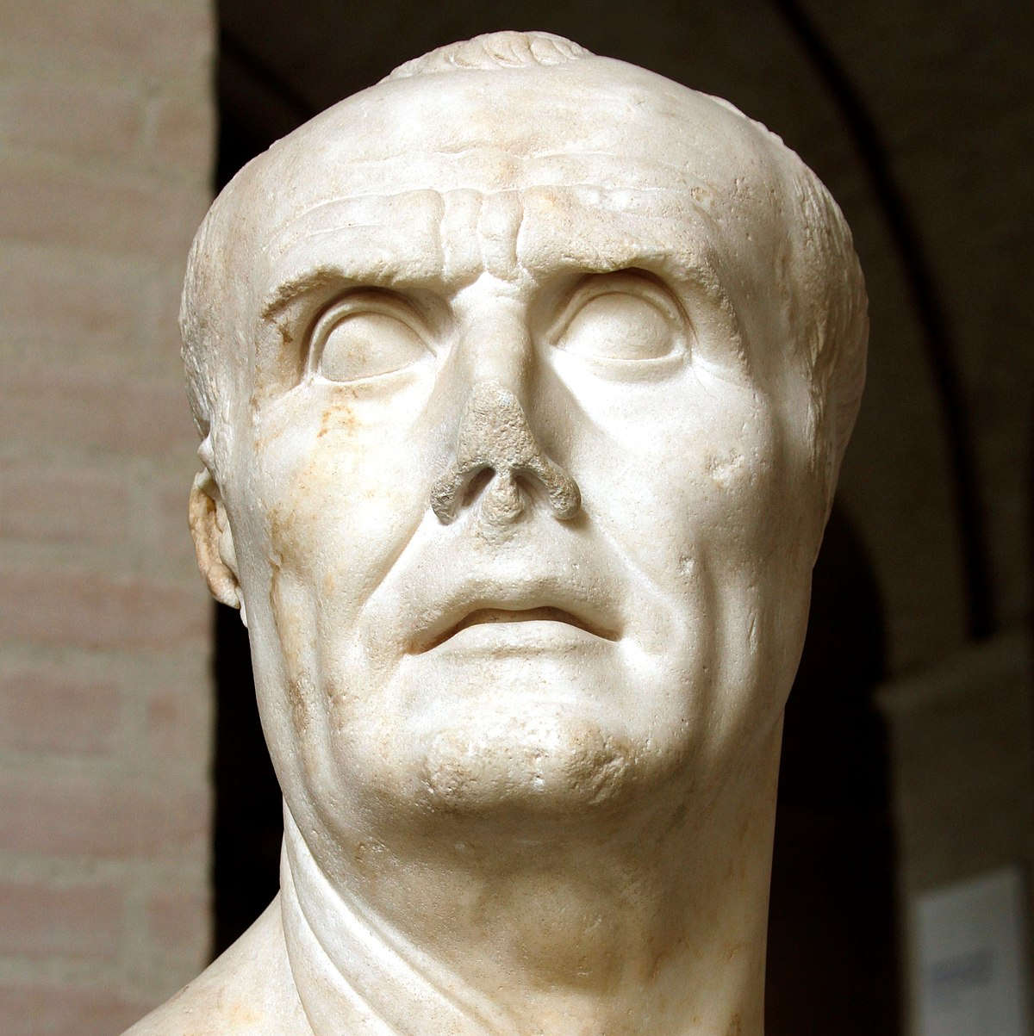
Marius’ impacts
GOAL/S: Evaluate Marius’ impacts, power and authority
Analyse sources
Week 7, Lesson 4

Slide 2
Impacts
Power
Authority

Slide 3
TEACHER ONLY
Short-Term Impacts:
Military Reforms:
Short-Term Change: Marius' reforms to the Roman army, including the recruitment of landless citizens and the creation of a professional army, resulted in immediate improvements in military effectiveness and cohesion.
Continuity: These reforms laid the foundation for the transformation of the Roman military into a professional force, which continued to shape Roman military strategy and tactics in the short term.
Political Ascendancy:
Short-Term Change: Marius' multiple consulships and military successes elevated his political stature, consolidating power in his hands and challenging traditional power structures within the Roman Republic.
Continuity: Marius' rise to power highlighted the growing influence of individual commanders and military achievements in Roman politics, a trend that would continue to shape political dynamics in the late Republic.

Slide 4
TEACHER ONLY
Long-Term Impacts:
Military Legacy:
Long-Term Change: Marius' military reforms established a precedent for the professionalization of the Roman army, influencing military organization and doctrine for centuries to come.
Continuity: The legacy of Marius' military reforms endured beyond his lifetime, contributing to the longevity and expansion of the Roman Empire.
Political Legacy:
Long-Term Change: Marius' political career set a precedent for ambitious military leaders to seek political power through military success, foreshadowing the rise of figures like Julius Caesar and Augustus.
Continuity: The consolidation of power in the hands of military leaders, as exemplified by Marius, contributed to the erosion of Republican institutions and the eventual transition to imperial rule.

Slide 5
TEACHER ONLY
Evaluation of Marius' Power and Authority:
Significance:
Military Innovator:
Marius' reforms to the Roman army revolutionized military recruitment and organization, ensuring the continued effectiveness and expansion of the Roman military.
His innovative military tactics and strategies contributed to significant victories against external threats, enhancing Rome's security and territorial expansion.
Political Trailblazer:
Marius' unprecedented seven consulships demonstrated his remarkable political acumen and ability to navigate the complexities of Roman politics.
His rise to power challenged traditional aristocratic dominance in Roman politics and paved the way for future military leaders to assert political authority.
Transformational Figure:
Marius' tenure as consul and his military achievements marked a turning point in Roman history, ushering in a new era characterized by the increasing influence of individual commanders and the erosion of Republican institutions.
His legacy as a transformative figure in Roman military and political affairs endured long after his death, shaping the trajectory of Roman history for centuries to come.

Slide 6
ACTIVITY – Practice Source Analysis

